Slide 1
Getting Started with Kubernetes and Rancher
Rancher Labs Training
#rancherk8s

Slide 2
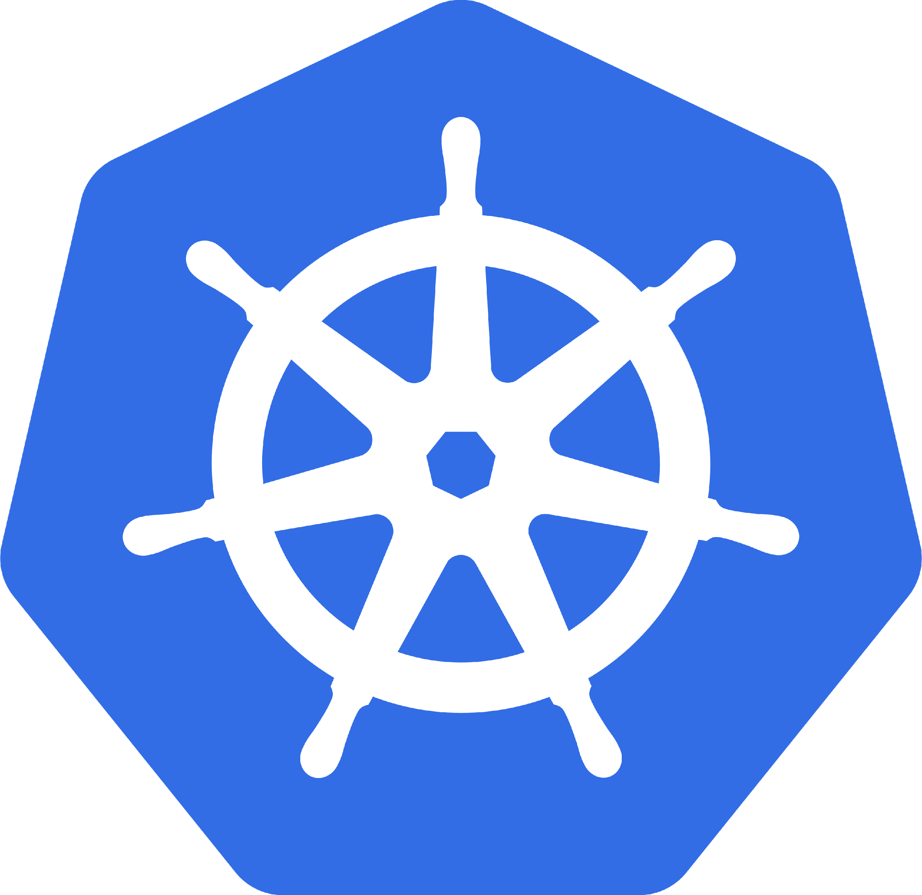
Today’s objectives
Technical introduction to Rancher
Keep the slides to a minimum
Demo, then demo some more

Slide 3
For the purpose of this training, we’re assuming you understand basic Docker concepts….
#rancherk8s

Slide 4
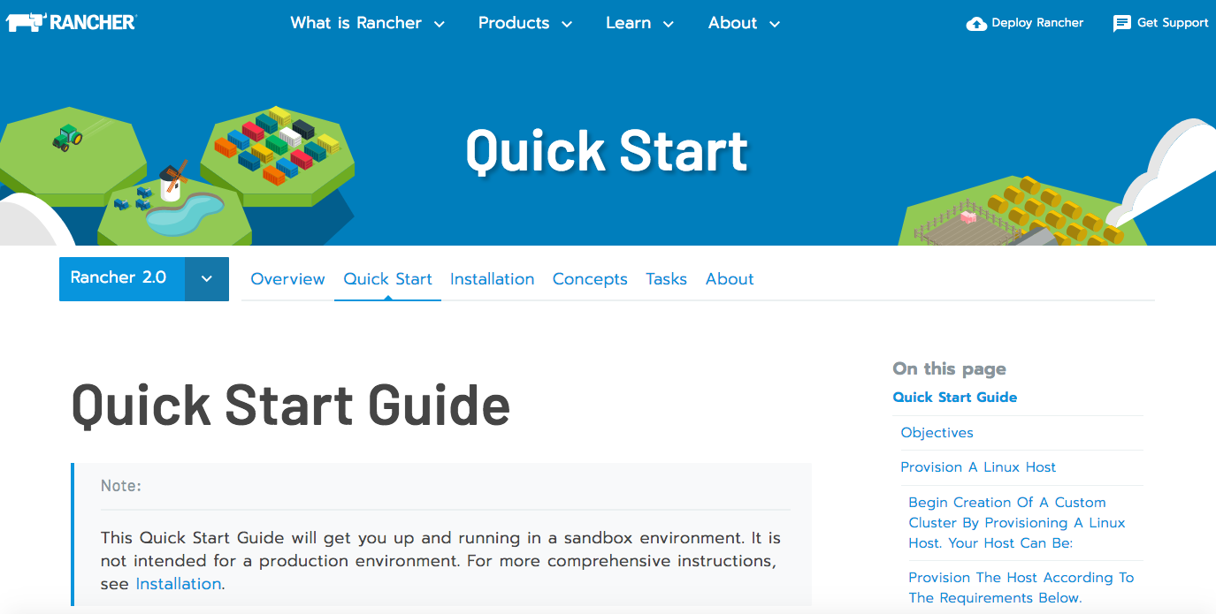
Resources - docs
https://rancher.com/docs/rancher/v2.x/en/quick-start-guide/
#rancherk8s

Slide 5
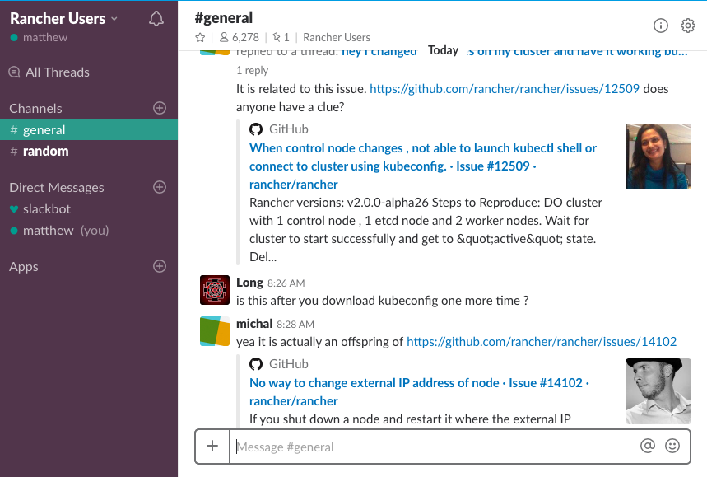
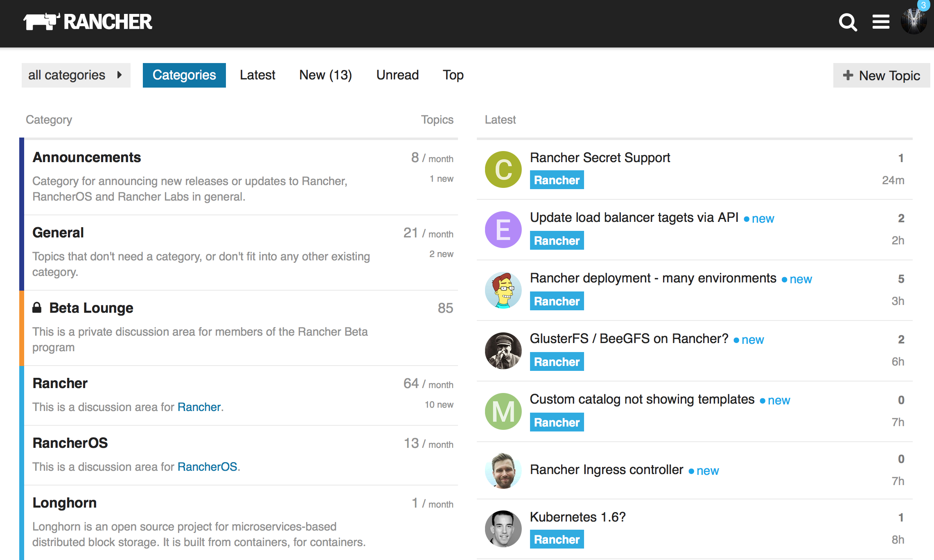
Resources – slack and forums
http://slack.rancher.io
http://forums.rancher.com
#rancherk8s

Slide 6
Notes:
Despite having massive participation from what seems like everyone on the planet, Kubernetes is not without its challenges.
Do any of these questions seem familiar? These are real concerns that Kubernetes users have every single day.
You want to be sure that the solution you choose today is flexible enough to meet your needs in the future

Slide 7
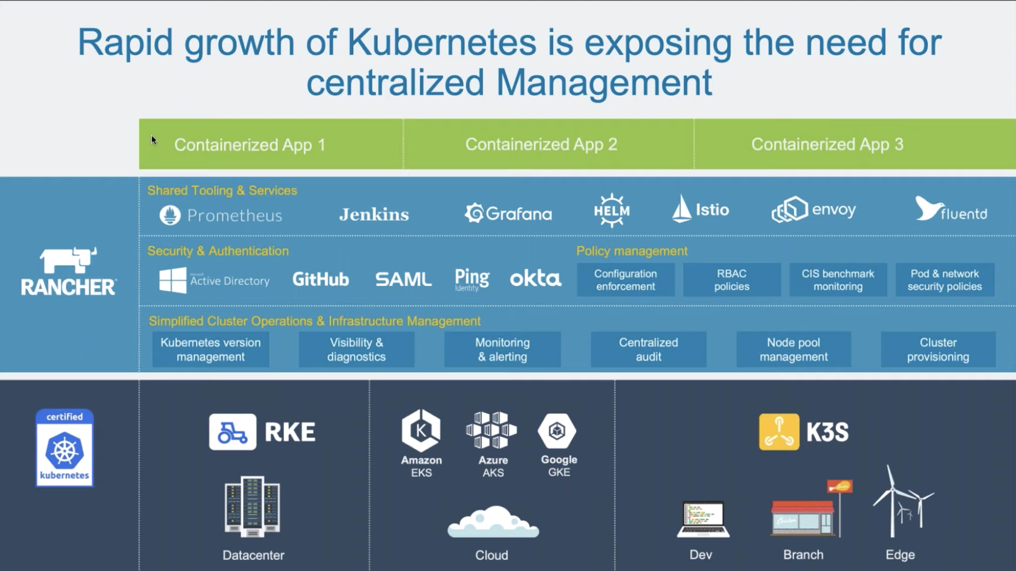
Notes:
...and they’re concerns that Rancher solves.
Pick your Kubernetes solution. Build it yourself, the hard way, or the easy way with Rancher Kubernetes Engine. Put it in the cloud. Use a hosted provider. It doesn’t matter. We can launch instances and install Kubernetes onto them. We can deploy and manage a hosted Kubernetes solution in any provider. If you already have Kubernetes clusters in the wild, we can import them and manage them like any other cluster.
What does management mean? It means that you can corral all of your clusters under one system, one highly-available point of control, without sacrificing any of the individual cluster independence. It means that you can bundle namespaces into projects and map strong authorization roles that grant the correct level of access to them. It means that the Active Directory or SAML infrastructure you already have can control access to Kubernetes clusters running _anywhere_. It means that you can readily see and control your capacity and thus your costs - you can scale infrastructure up or down based on metrics you control.
That all sounds great for cluster admins, but what about the people using the clusters? Maybe you’re new to Kubernetes or just want to spin workloads up and down quickly. Our user interface lets you deploy applications that are as simple or as complex as you need them to be, and it lets you do so quickly. What about monitoring and logging? Use the integrated metrics server or the integrated logging server, or plug in an external system of your choice. What about traditional access via kubectl? All of that’s available, and all of it adheres to the RBAC policies.
Do you want to package your application with Helm and make it available to others, or do you want the confidence that comes from using the Helm charts that others have made? Use the app catalog. What about CI/CD? Use Rancher’s pipelines.
Rancher gives you total freedom, and it’s 100% free and open source.

Slide 8
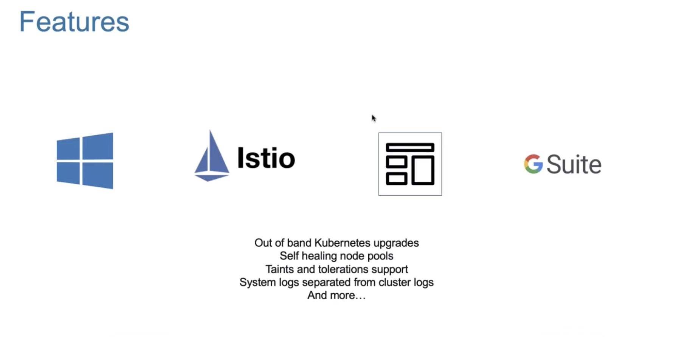

Slide 9
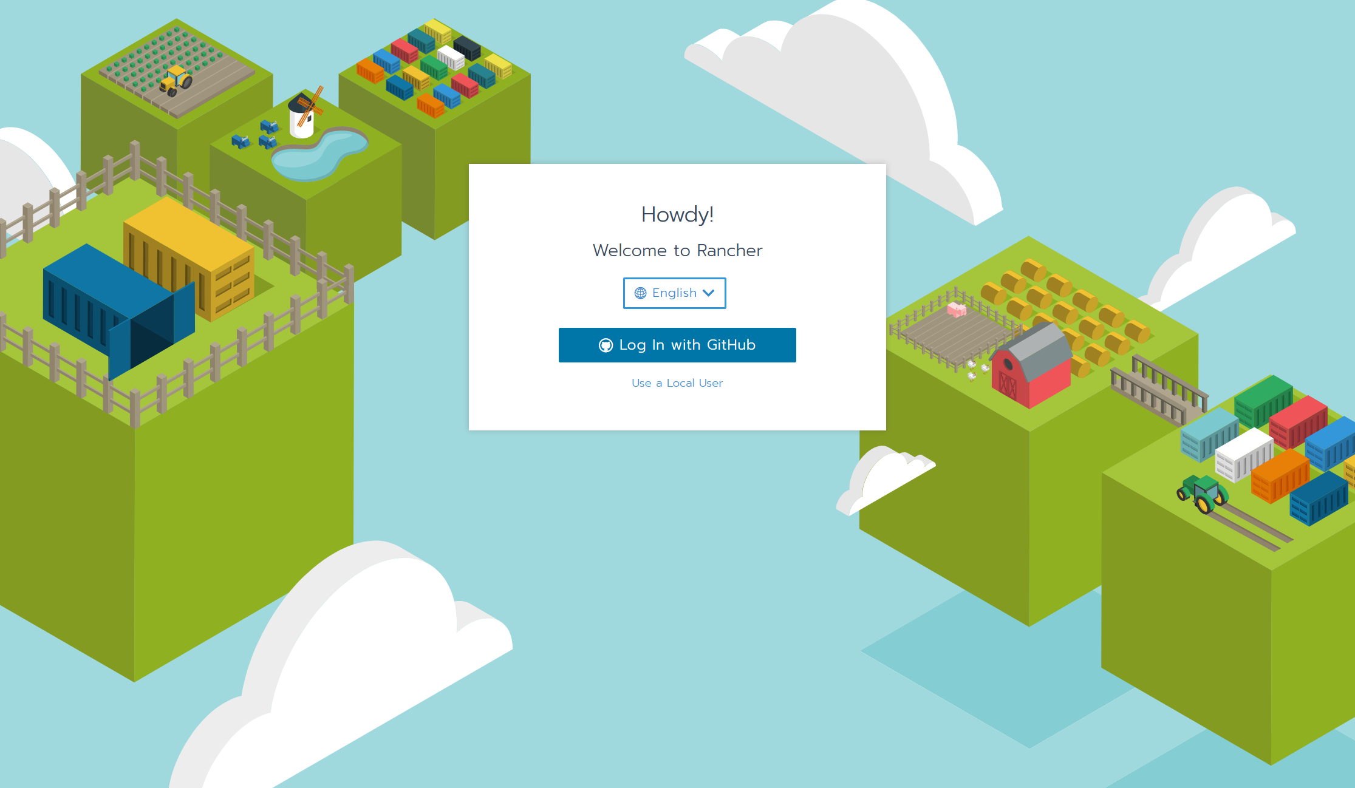
Rancher Time

Slide 10
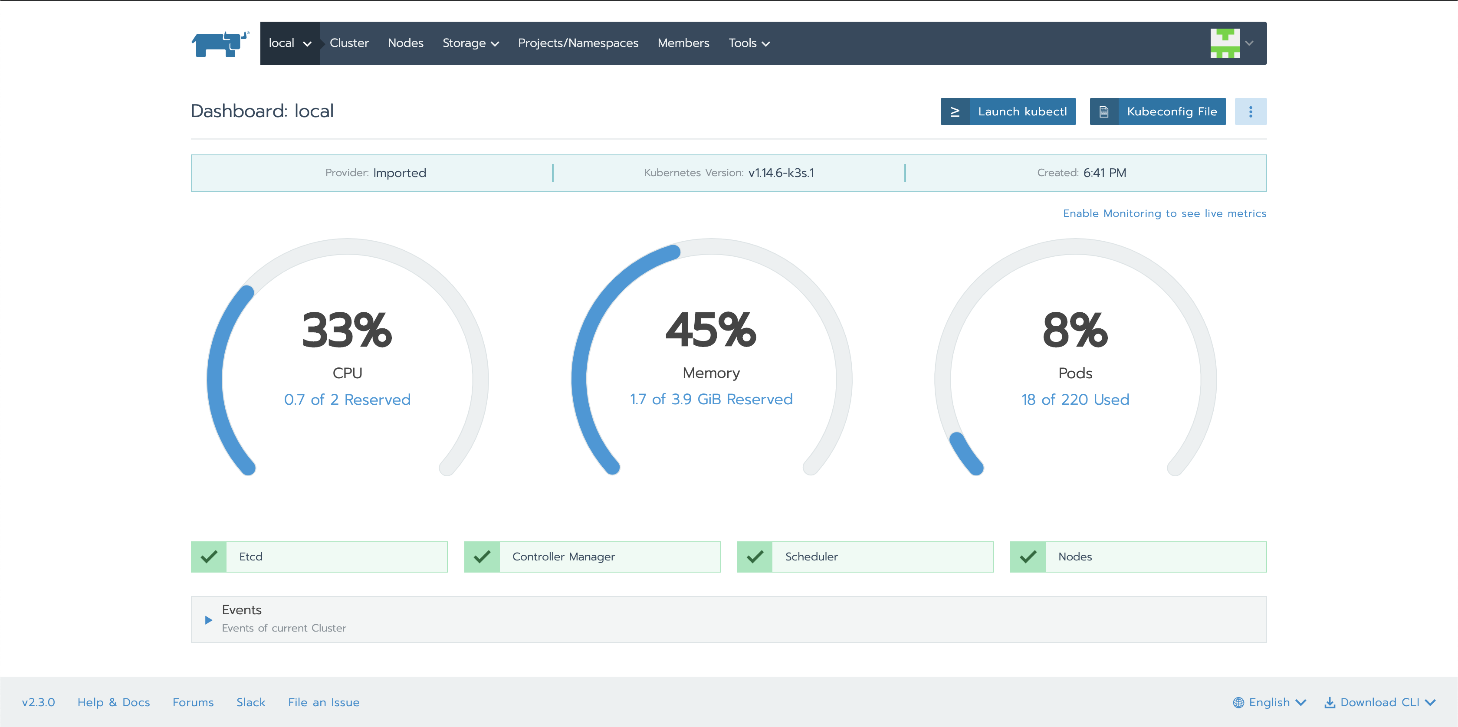

Slide 11
Follow Me For More Content
My name is Saiyam Pathak
saiyampathak
https://medium.com/@saiyampathak

Slide 12

Join other Rancher users in Slack
https://slack.rancher.io
#Kubernetes channel

Slide 13
Thank you
rancher.com/Kubernetes-master-class
#rancherk8s

